Slide 1

PREDICT THE SEGMENT-
SATYAPRIYA CHAUDARI
SANCHITA MANGALE
ABHISHEK SINGH
HARSHIT KANODIA
ANUJ SADANANDAN
NISHI PARAMESHWARA

Slide 2

CONTENTS

Slide 3
PROBLEM STATEMENT
DATA DESCRIPTION
FEATURE DESCRIPTION
FEATURE ENGINEERING
MACHINE LEARNING
FUTURE SCOPE

Slide 4
PROBLEM STATEMENT

Slide 5

hotstar uses customer “watch patterns” to fine tune demo-targeting, an important aspect of advertising.
GOAL: Machine Learning Model to predict customer behaviour from known customer watch patterns.

Slide 6
DATA DESCRIPTION

Slide 7
6 Features
Training Data Set: 200,000 customers (JSON Dict)
Test Data Set: 100,000 customers (JSON Dict)
Description ID: a unique identifier

Slide 8
FEATURE DESCRIPTION

Slide 9
FEATURES
titles
dow
genres
tod
cities
segment
Target variable

Slide 10
titles: eg: title:watch_time
genres: same format as titles
cities: same format as titles
tod: (24 hours), eg: time_of_day:watch_time
dow: (7 days format), eg: day_of_week:watch_time
segment (target variable): For modelling, encode pos = 1, neg = 0

Slide 11
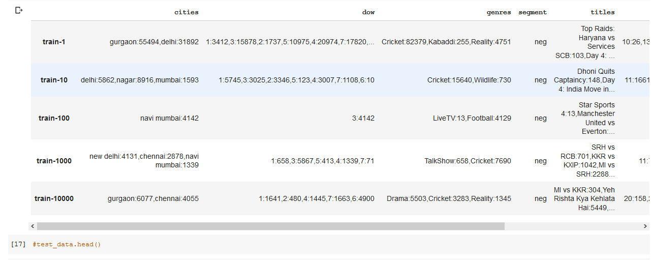

Slide 12
FEATURE ENGINEERING

Slide 13
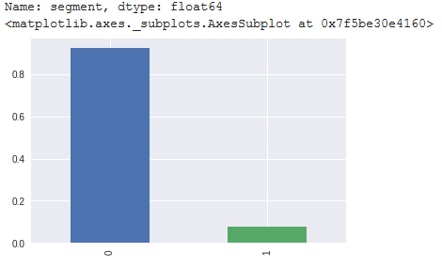
Distribution of y variable (Positive (1)- 0.076, Negative (0)- 0.924

Slide 14
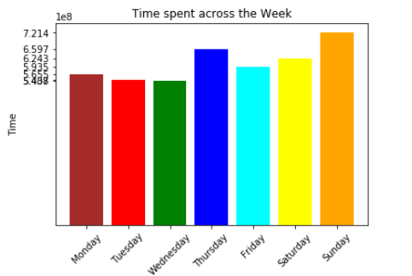
Time spent across all days of week bifurcated in the 7 days format

Slide 15
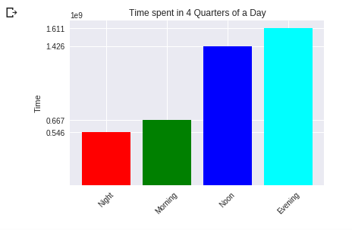
Hourly data clubbed into 4 intervals of 6 hours each

Slide 16
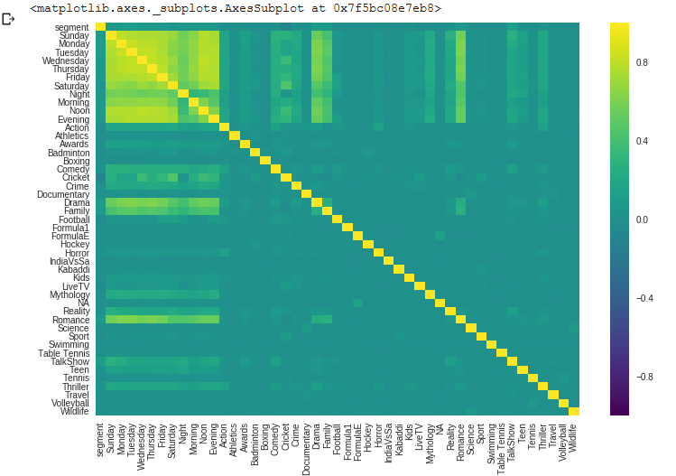
Heat map of 47 features engineered

Slide 17
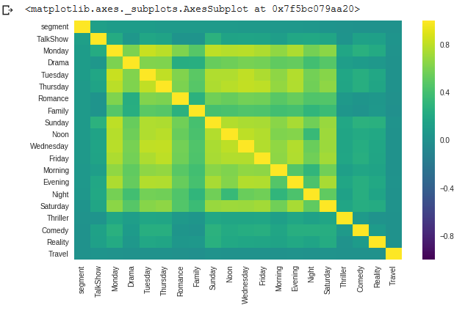
Heat map of top 20 correlated features with target variable segment

Slide 18
MACHINE LEARNING

Slide 19
Random Forest
ROC, AUC Score: 0.51
Recall: 0.02
Precision: 0.29
F1: 0.04

Slide 20
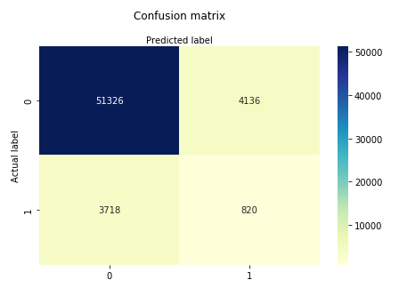
Decision Tree
No. of Features with highest ROC, AUC Score: 30
ROC, AUC Score: 0.56

Slide 21
FUTURE SCOPE

Slide 22
Club cities feature to reduce dimensionality and avoid system lagging.
Better Feature engineering on other features.
More detailed Exploratory Data Analysis
Clustering to segment users and use it as features of machine learning models.
Efficient Tuning of existing machine learning models
Use XGBoost, SMOTE, Grid Search machine learning models

Slide 23


